Slide 1

Motion Control：Lecture 4.1 NURBS Curves and Smoothening of sharp corners
Jiangang Li
Nov 14 2016

Slide 2
Index
NURBS Curve
2. Smoothening of sharp corners

Slide 3
1.Non Uniform Rational B-Spline(NURBS)
1.1 Power Basis Curve
1.2 Bezier Curves
1.3 B-Spline Curves
1.4 NURBS

Slide 4
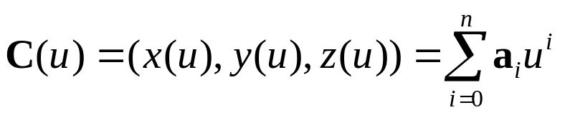

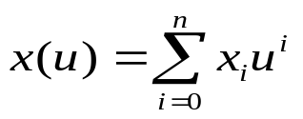
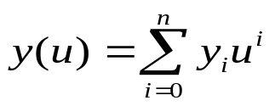
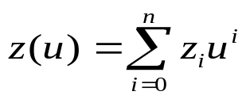




1.1 Power Basis Curve
An nth-degree power basis curve:
The ai=(xi,yi,zi) are vector, hence
Given , the point on a power basis curve is most efficiently computed using Horner’s method
For degree=1:
degree=2:
.
.
degree=n:

Slide 5
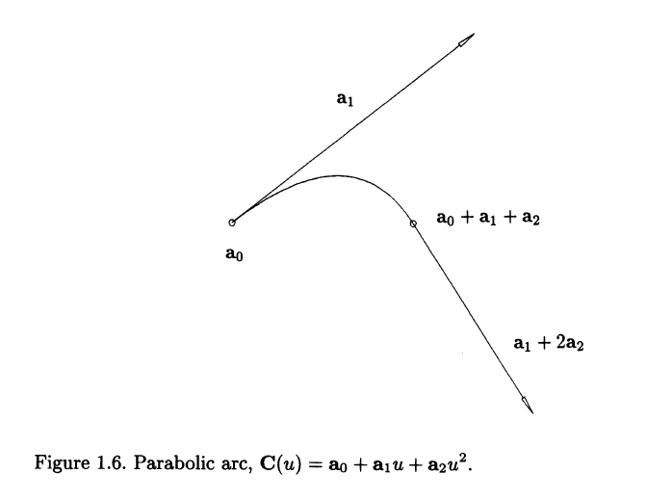
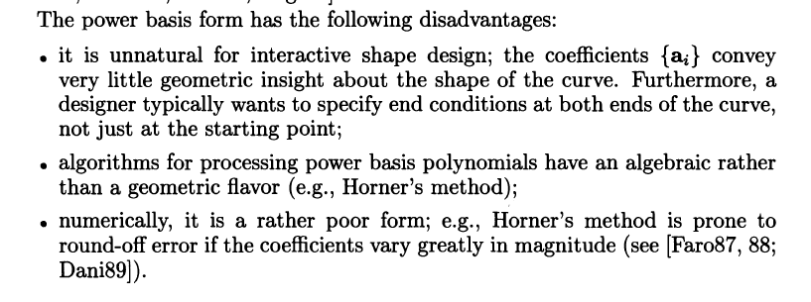
1.1 Power Basis Curve

Slide 6
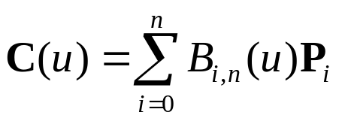

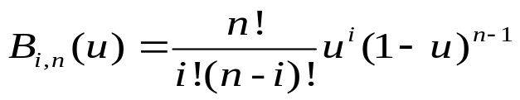



1.2 Bezier Curves
An nth-degree Bezier curve:
The basis functions, ,are the classical nth-degree Bernstein polynomials given by
the geometric coefficients of this form, ,are called control points.
For n=1:
n=2:
n=3:
. .
. .

Slide 7
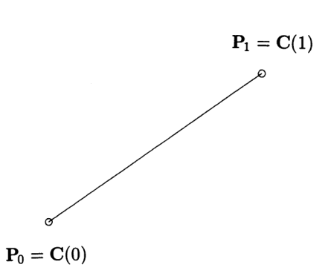
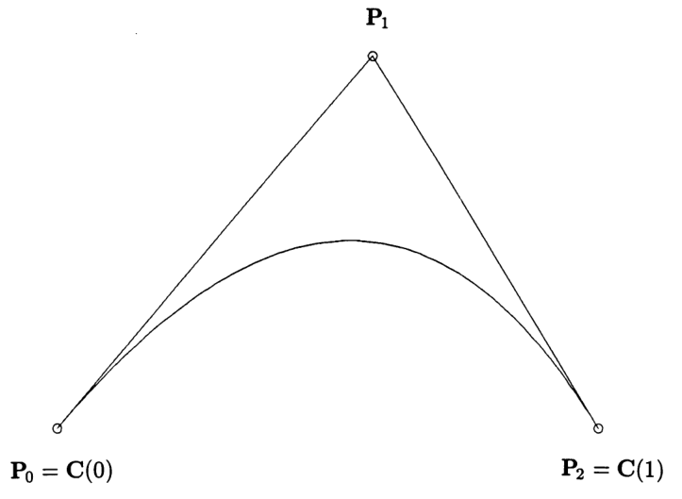






1.2 Bezier Curves
Figure 1. First-degree Bezier curve Figure 2. Second-degree Bezier curve
We can notice that from figure 2:
1, the polygon formed by ,called the control polygon, approximates the shape of the curve rather nicely;
2, and ;
3, the tangent directions to the curve at its endpoints are parallel to
and
4, the curve is contained in the triangle formed by .

Slide 8
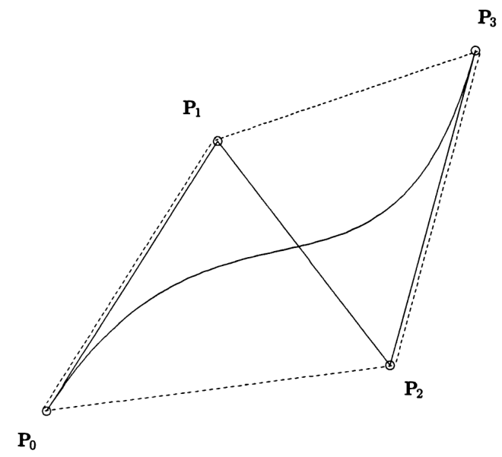
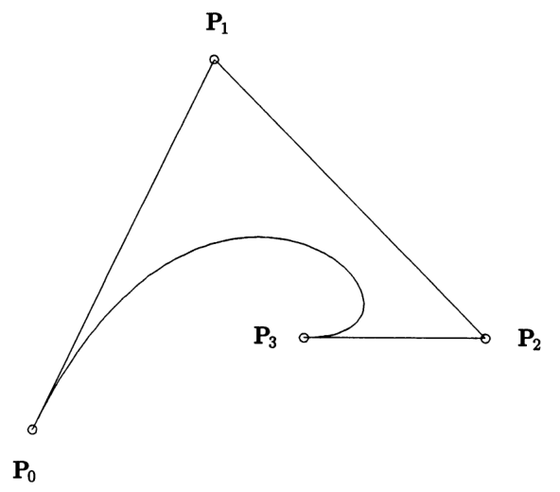
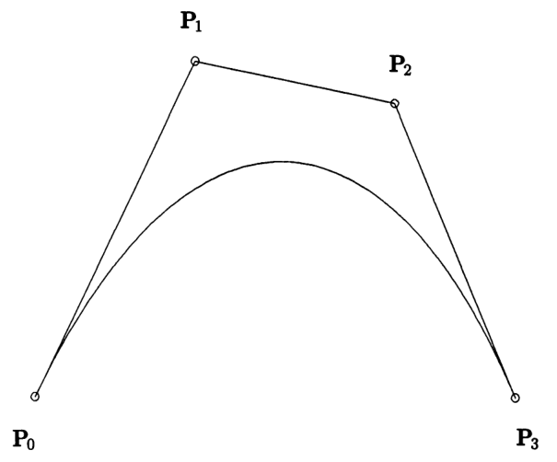
1.2 Bezier Curves
(a) (b) (c)
Figure 3. Cubic Bezier curve
In addition to previous properties ,we also can conclude that from figure 3:
convex hull property: the curves are contained in the convex hulls of their defining control points.

Slide 9

1.2 Bezier Curves
Shortcomings of Bezier Curve:
1.a high degree is required in order to satisfy a large number of constraints;
e.g.,(n-1)-degree is needed to pass a polynomial Bezier curve through n data points.
2.a high degree is required to accurately fit some complex shapes;
3.although Bezier curve can be shaped by means of their control points, the control is not sufficiently local.
a. First-degree Bezier curve(2 points) b. Second-degree Bezier curve(3 points) c. Cubic Bezier curve(4 points)
Figure 4. three Bezier curves

Slide 10
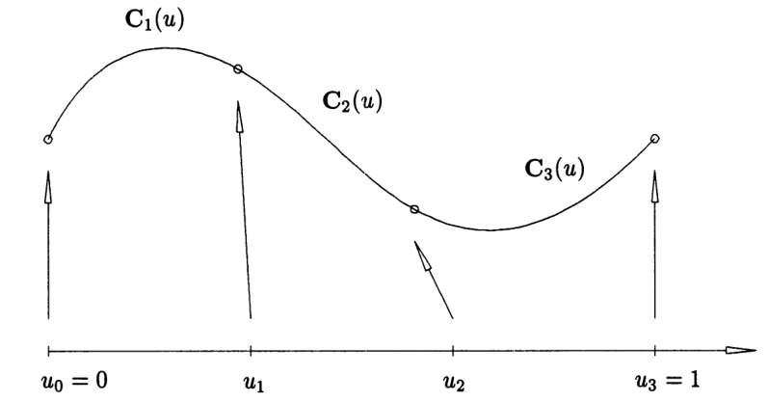
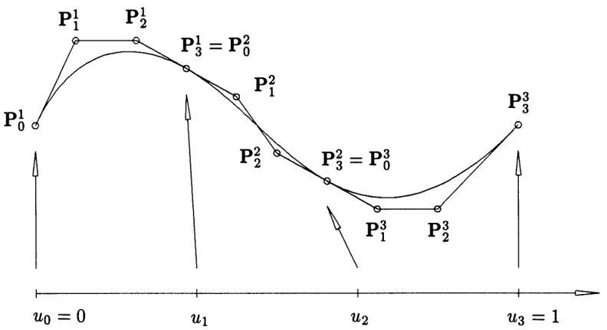
1.3 B-Spline Curves
The solution: piecewise polynomial
Figure 5. A piecewise cubic polynomial curve with three segments
Figure 6. the curve of Figure 5 shown with the polynomial segments represented in Bezier form

Slide 11

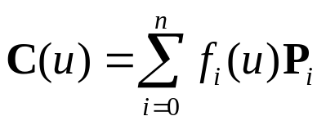


1.3 B-Spline Curves
But storing and manipulating the individual polynomial segments of a piecewise polynomial curve is not the ideal method for handing such curves.
1. redundant data must be stored;
2. for the Bezier form, the continuity of depends on the positions of the control points, hence there is little flexibility in positioning control points while maintaining continuity.
3. determining the continuity of a curve requires computation.
We want a represent a curve in the following form:
Where, are control points ; are piecewise polynomial functions forming a basis for the vector spaces of all piecewise polynomial functions of the desired degree and continuity.
Finally, given appropriate piecewise polynomial basis functions, we can construct piecewise curves.

Slide 12




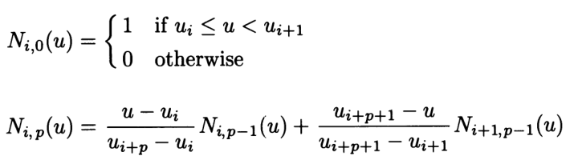
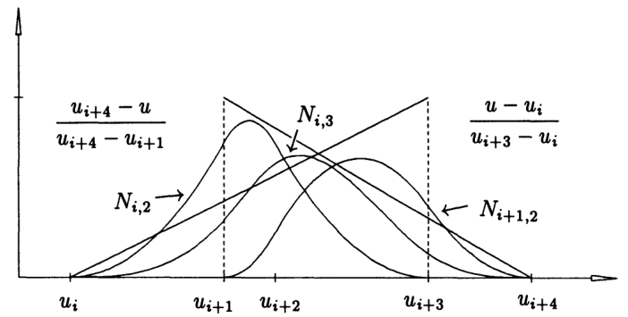
1.3 B-Spline Curves
Let be a non-decreasing sequence of real numbers. The are called
knots, and is the knot vector. The ith B-spline basis function of p-degree, denote by , is defined as
Figure 7. the recursive definition of B-spline basis function

Slide 13
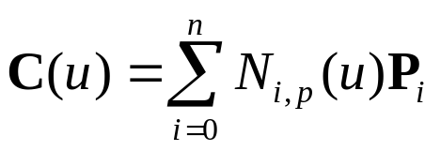



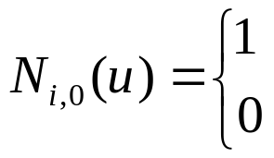

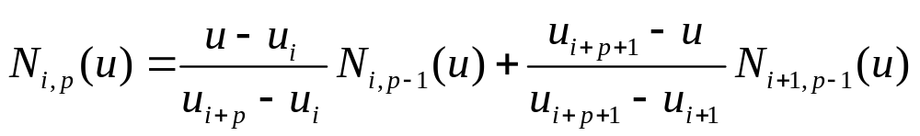
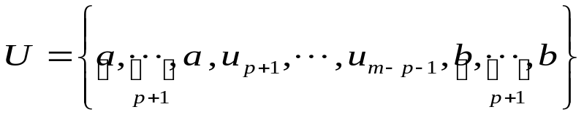
1.3 B-Spline Curves
A pth-degree B-spline curve is defined by
Where, ——control points;
——the pth-degree B-spline basis functions;
——knot vector.
if
otherwise

Slide 14


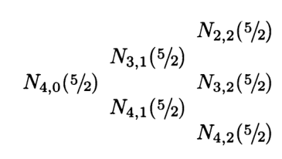
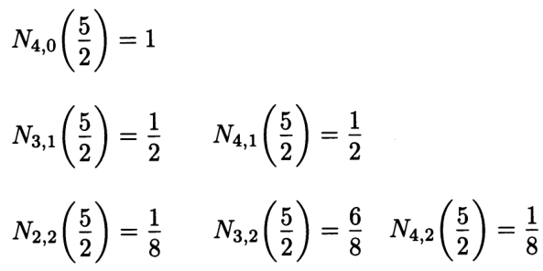
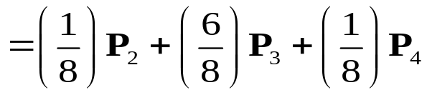
1.3 B-Spline Curves
Example
let p=2, U={0,0,0,1,2,3,4,4,5,5,5},and u=2.5 ,compute ?
Solution: since ,so i=4, we compute
Multiplying with the control points yields
if

Slide 15
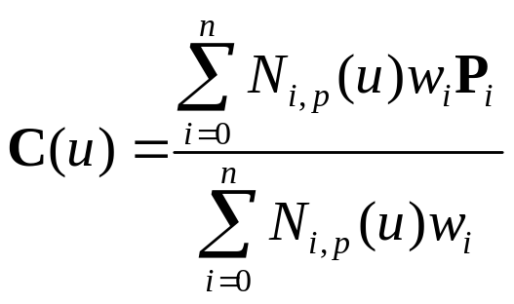


1.4 NURBS
A pth-degree NURBS curve is defined by
Where, ——control points;
——the pth-degree B-spline basis functions;
——weights;
——knot vector.

Slide 16
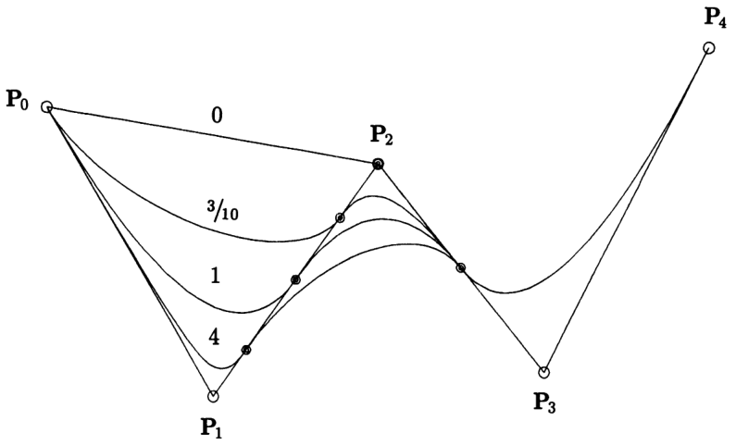
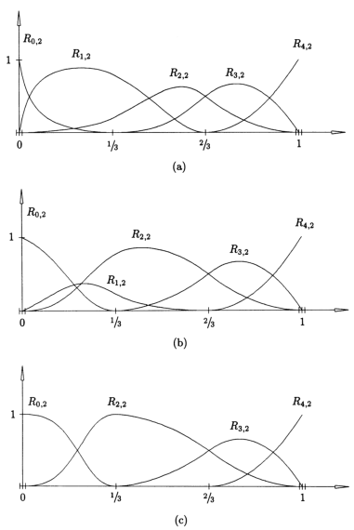

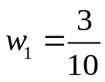


1.4 NURBS
Figure 8. Quadratic NURBS, with varying
Figure 9. The quadratic basis function for the curve of Figure 8.

Slide 17



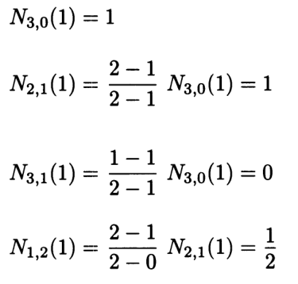
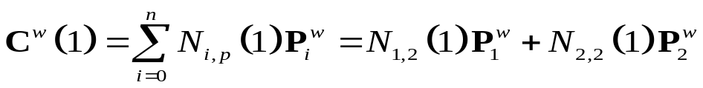
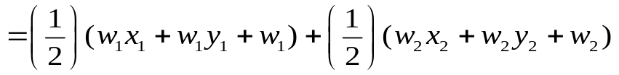
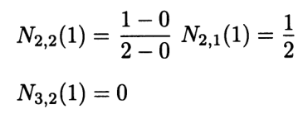
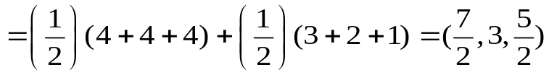
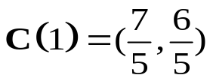
1.4 NURBS
Example
let U={0,0,0,1,2, 3,3,3}, ,
Compute ?
Solution: since ,so i=3, and
Hence
Projecting yields

Slide 18
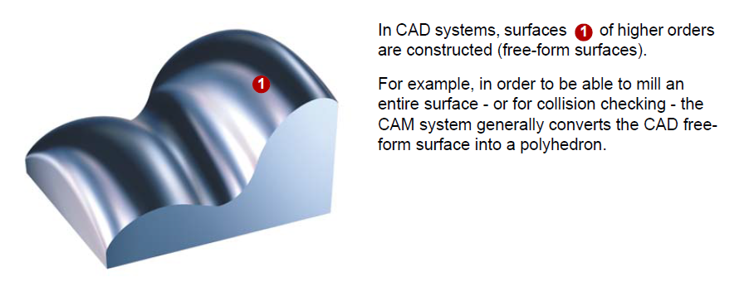
2 Smoothening of sharp corners

Slide 19
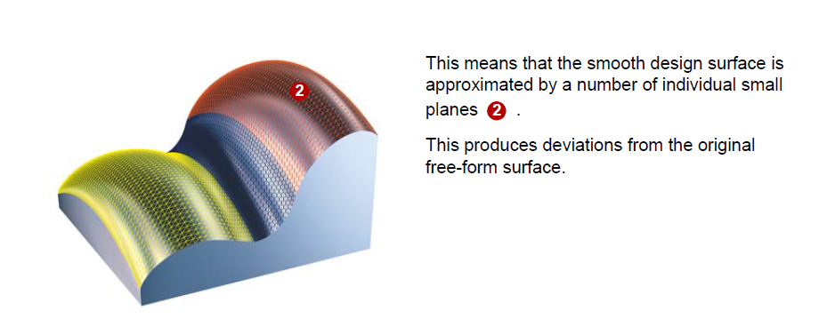
2 Smoothening of sharp corners

Slide 20
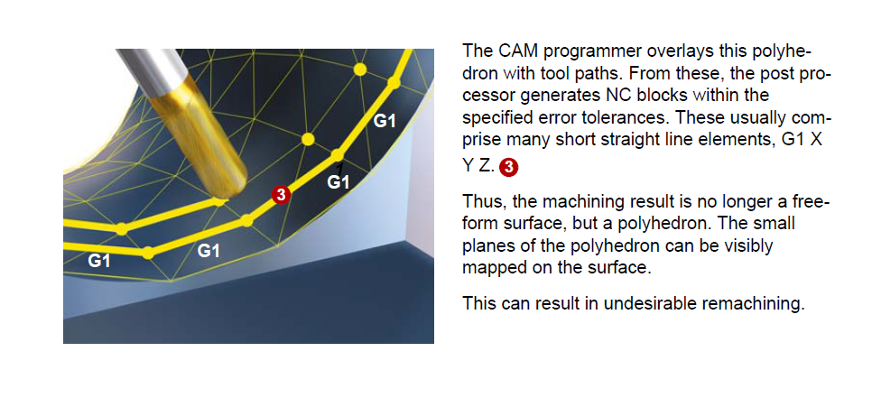
2 Smoothening of sharp corners

Slide 21
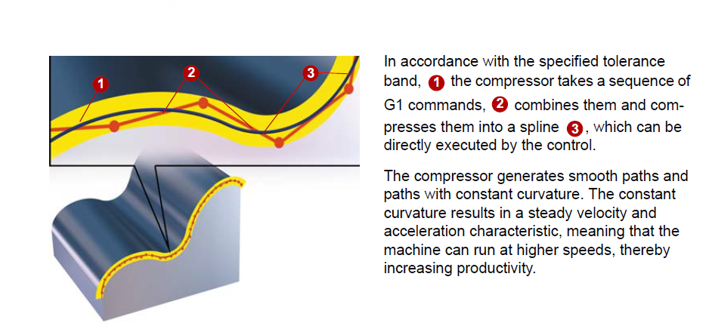
2 Smoothening of sharp corners

Slide 22
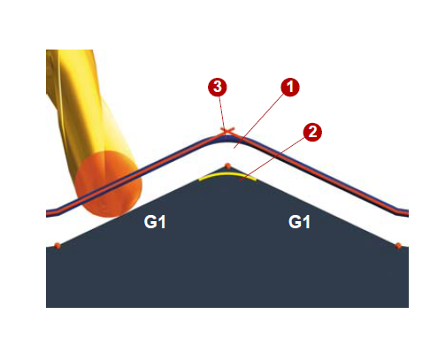
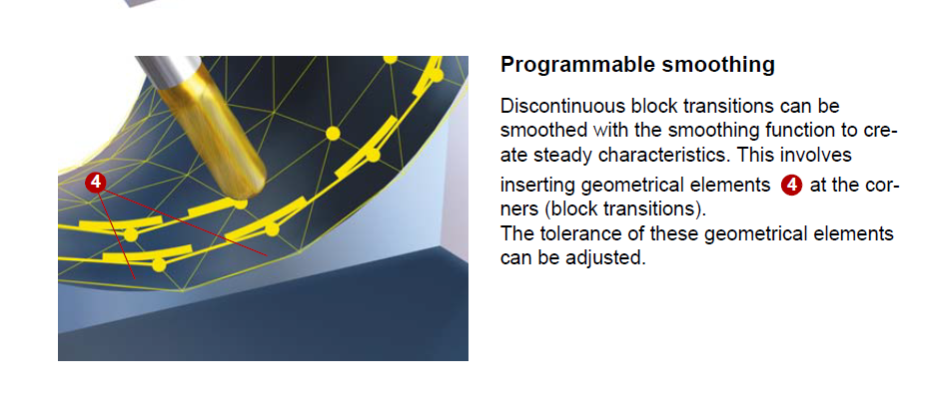
2 Smoothening of sharp corners

Slide 23
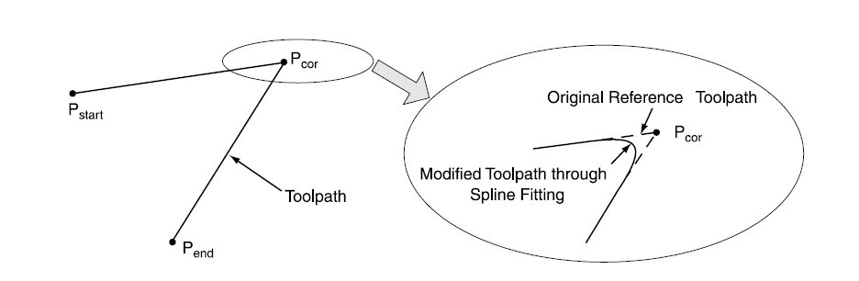
2 Smoothening of sharp corners
2.2 Smoothening of sharp corners with arc or curve

Slide 24
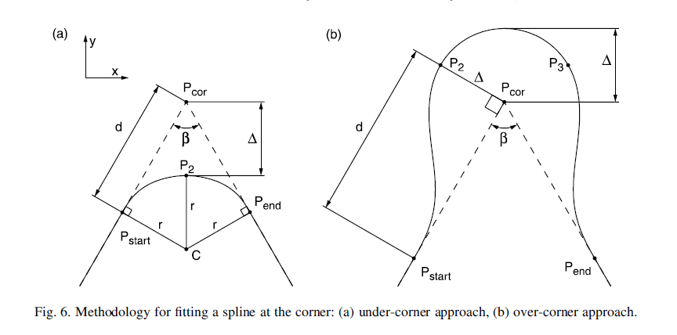
2 Smoothening of sharp corners

Slide 25
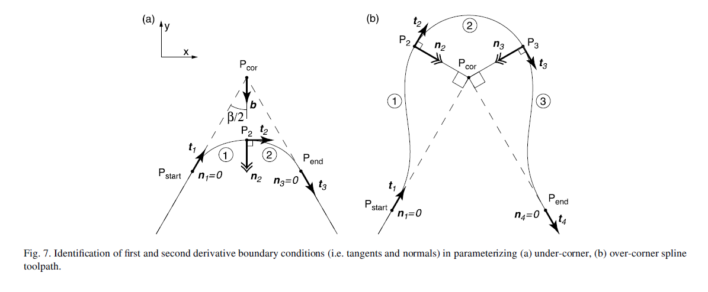
2 Smoothening of sharp corners

